Slide 1

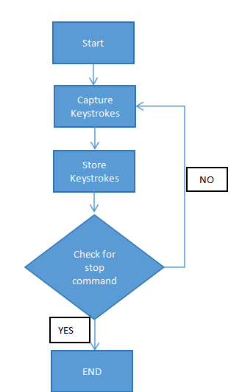

MIT SCHOOL OF COMPUTING
Class : SY14
Group Id: 03
DEPARTMENT OF COMPUTER SCIENCE & ENGINEERING
Keylogger
A surveillance software for companies and parents.
Durgesh Borse, Hemanshu Moundekar, Sourabh Karmakar
Faculty Guide:
Prof. Uday Mande
EMPATHY CHART:
IDEATION:
FLOWCHART:
What Users Says: I don’t know what is my child’s activity on internet. I don’t know what my employee’s does on company’s device. | What Users Thinks: Is there a software by which I can monitor what’s my child doing. Is there a way I can see what employee’s are doing in company’s device.
What Users Does: They forces employee’s to download remote desktop software. They don’t give children privacy they need while growing up. | What Users Feels: They can’t trust anyone. They are always invading privacy of there children.
Ideation on keyloggers involves considering their ethical and practical implications. Keyloggers, software or hardware tools that record keystrokes on a computer, can serve legitimate purposes like parental control or employee monitoring. However, they are frequently associated with malicious intent, such as stealing sensitive information like passwords or financial data. Ethical considerations include ensuring user consent and lawful use. From a practical standpoint, keyloggers require robust security measures to prevent misuse and protect user privacy. Moreover, understanding how attackers employ keyloggers informs defensive strategies, making them crucial in cybersecurity education and defense.
Problem statement
The need for keyloggers arises primarily in security-related scenarios such as monitoring employee activity, parental control, or investigating unauthorized access. However, keyloggers also pose significant ethical and privacy concerns when used without consent, leading to potential misuse, data breaches, and legal implications.
Proposed Solution
Design a software to record the keystrokes entered on a computer or mobile device. It operates covertly in the background, capturing every key pressed by the user, including passwords, usernames, messages, and other sensitive information. Keyloggers can function at various levels of the operating system, from the kernel to user-space applications, enabling them to intercept keystrokes before they reach their intended destination.
Scope and Feasibility
Developing a software to monitoring employee activity for security purposes, parental control to ensure child safety online, and forensic investigations into unauthorized access. In these contexts, keyloggers can provide valuable insights into user behavior and help prevent security breaches or identify wrongdoing.

